Slide 1
Sewing & tailoring
Spiritual worshop
Anglicana / Iglesia Episcopal.
San Miguel de Allende

Slide 2
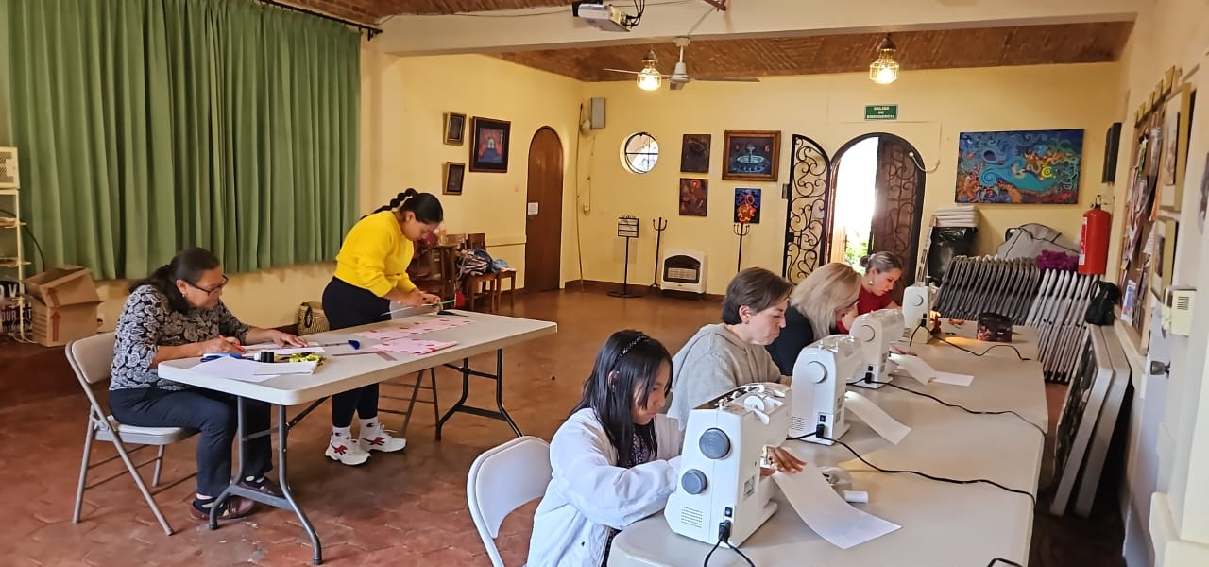
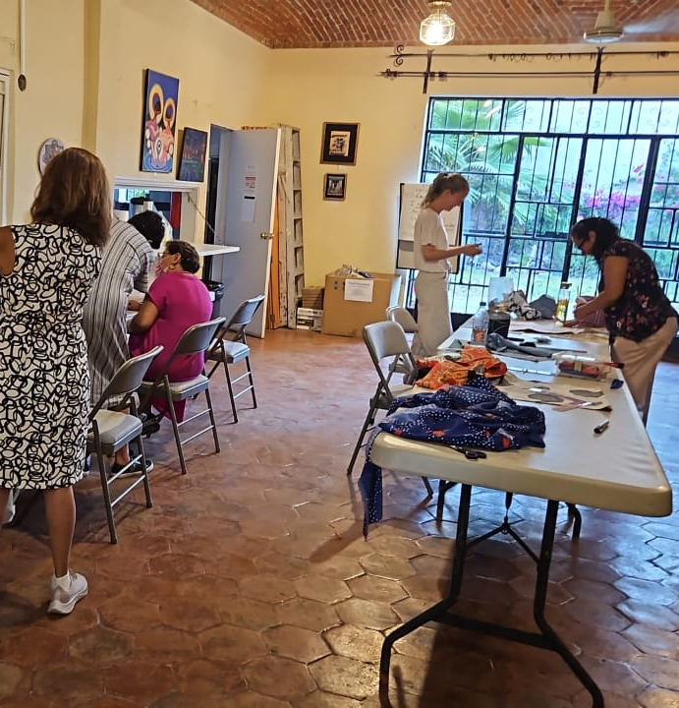
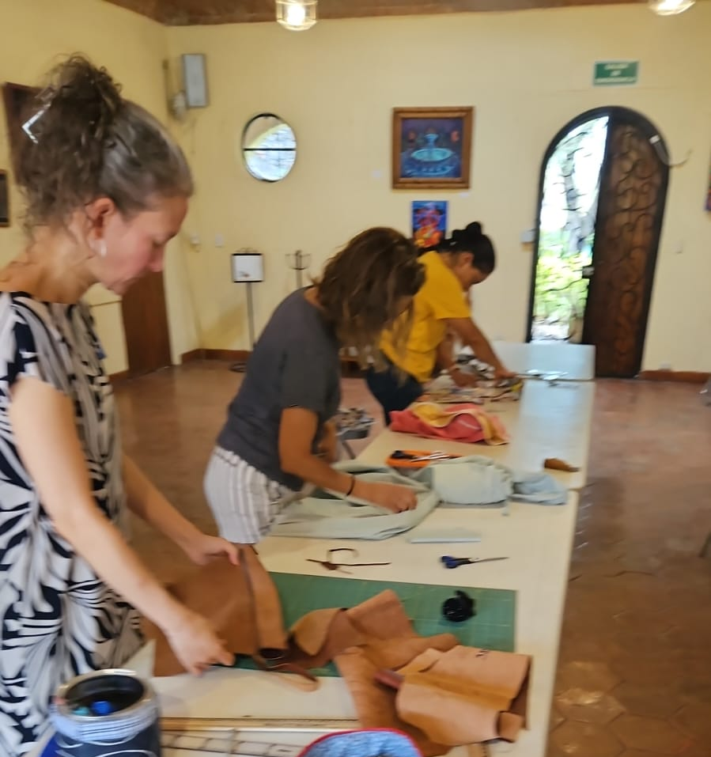
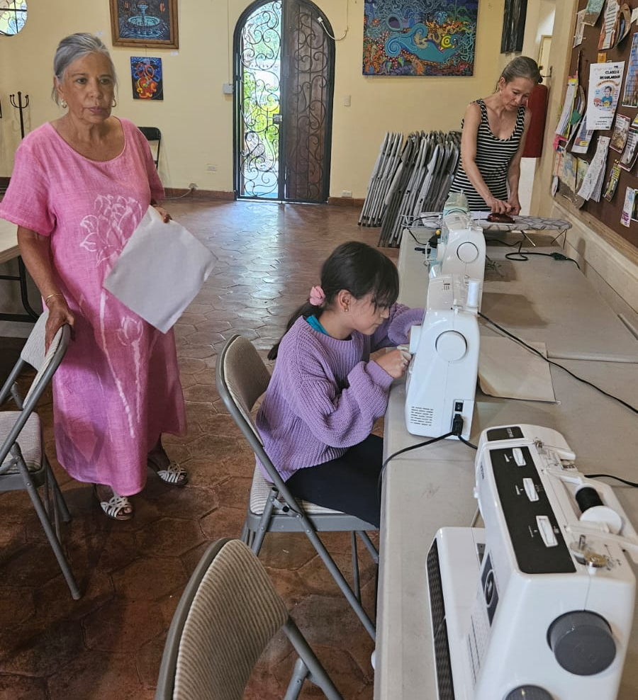
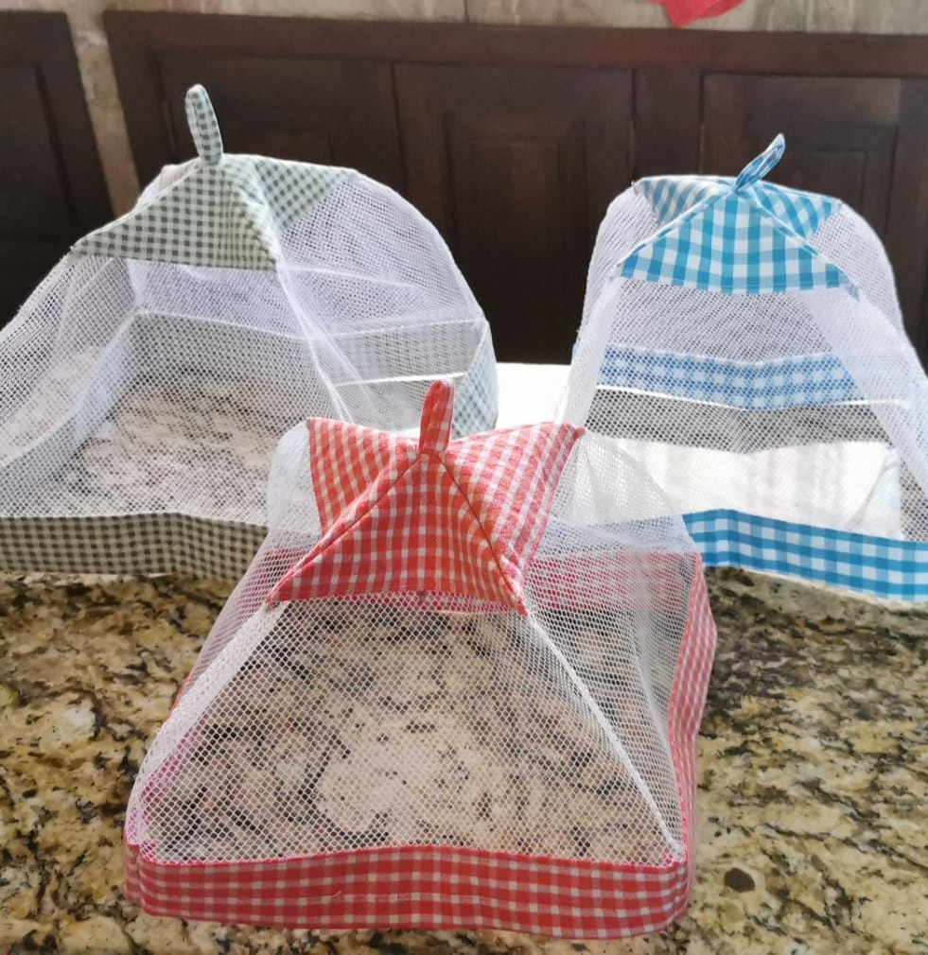

Slide 3
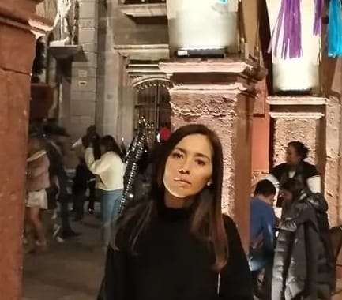
Rebeca Ramírez is a successful and pretty
businesswoman from San Miguel de Allende.
Rebeca joined St. Paul´s recently and likes the Sunday Eucharist. She has been inspired by our ministries, such as the free padel tennis classes. So, moved by our work and feeling a call in her spirit to assist our community, she has offered to teach woman and men who like to sew using electrical machines.

Slide 4
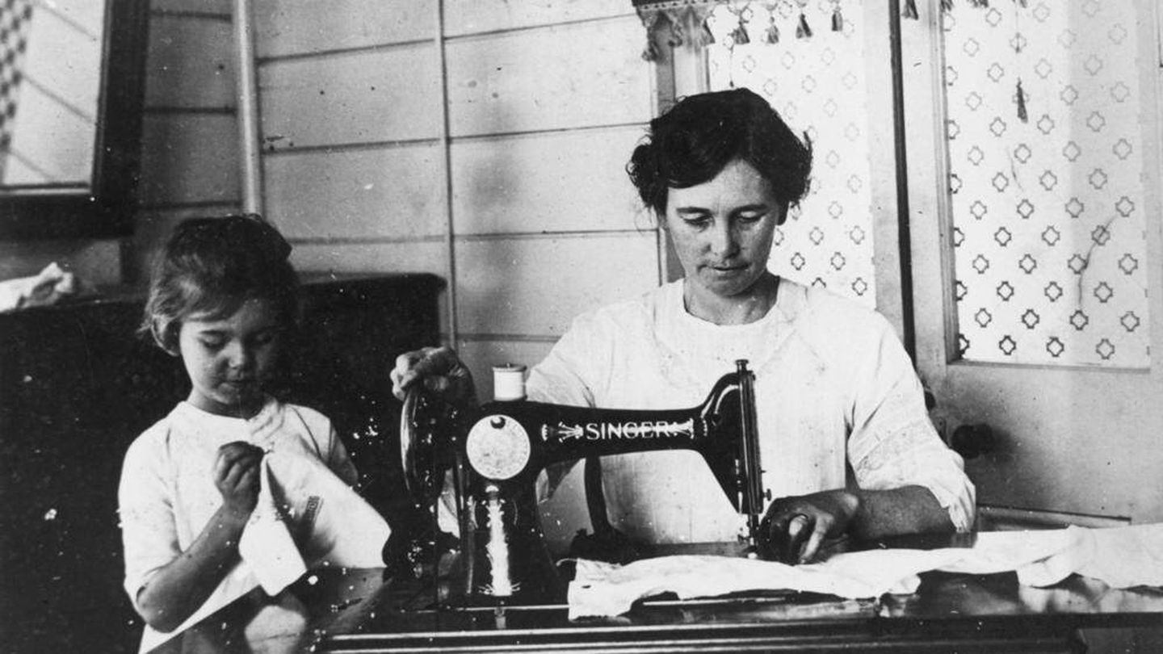
Name of the program
“Mujeres tejiendo con espíritu”

Slide 5
Mission
To promote sewing classes for men and woman to support them in developing new ways of establishing income and providing them tools to repair and make their own cloths, bags, etc.

Slide 6
Vision
Offering 2 machines, materials and instructions to under-served woman and men, offering a spiritual context as they develop new skills.

Slide 7
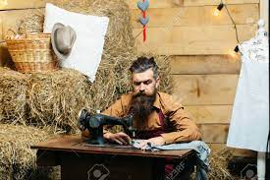
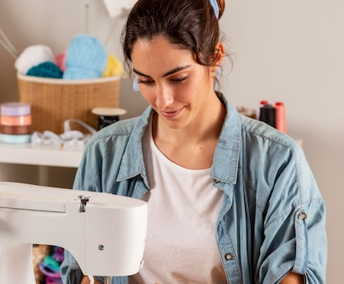
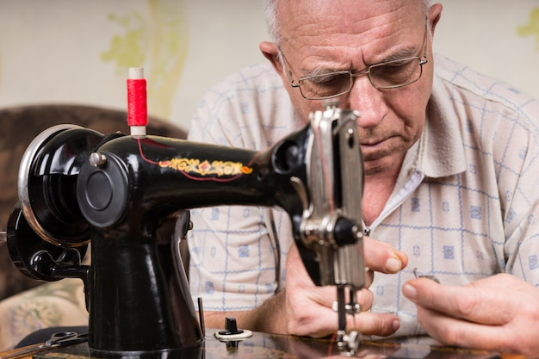

Slide 8
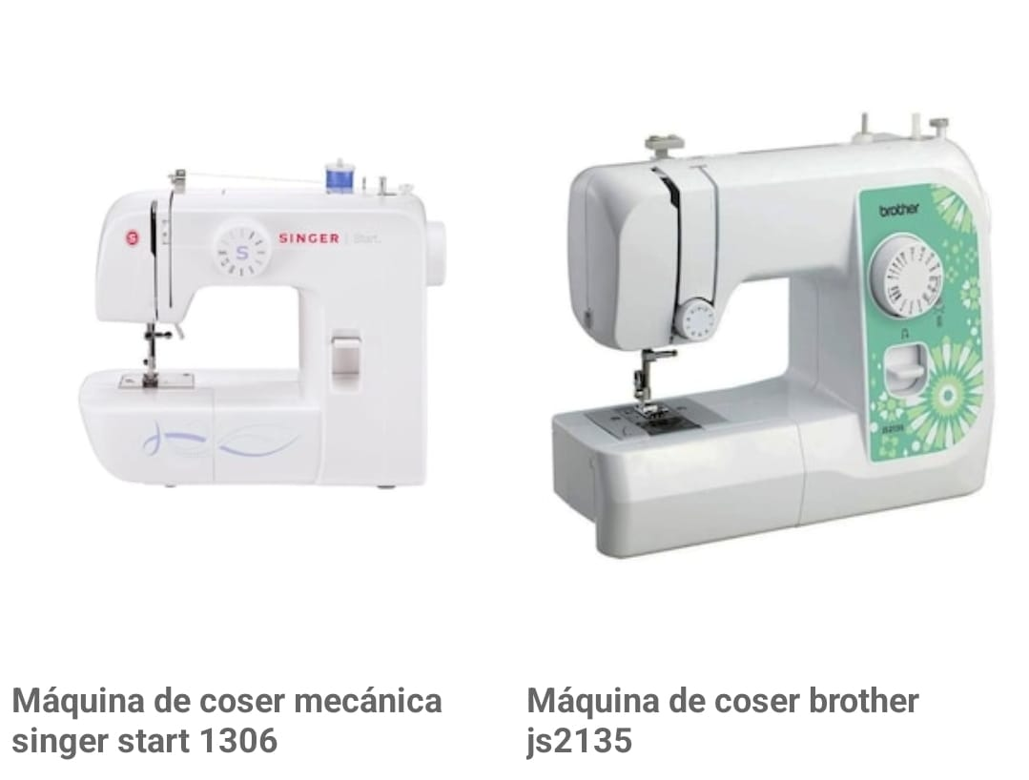
Expenses to began
The purchase of 2 machines for sewing: $6,000.00 (Mexican pesos)

Slide 9
Salaries
“None”
Matthew 6:3-4.- But when you give, do not let your left hand know what your right hand is doing, ⁴ so that your giving may be in secret. Then your Father, who sees what is done in secret, will reward you.

Slide 10
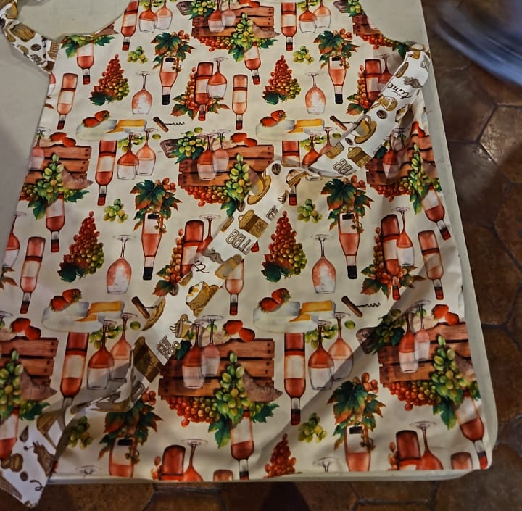
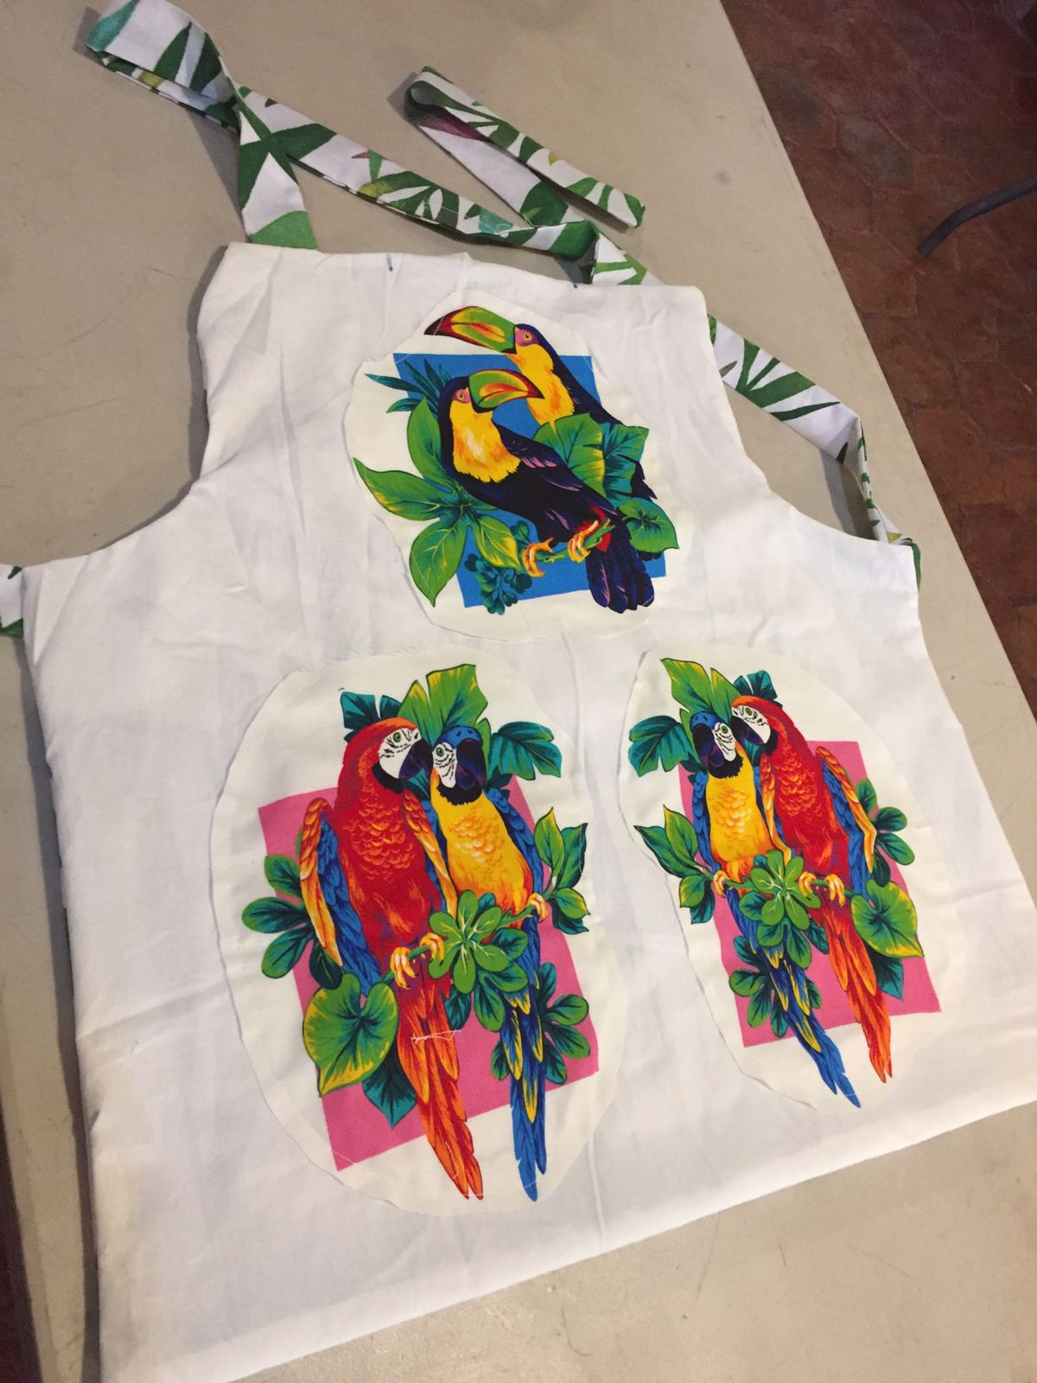
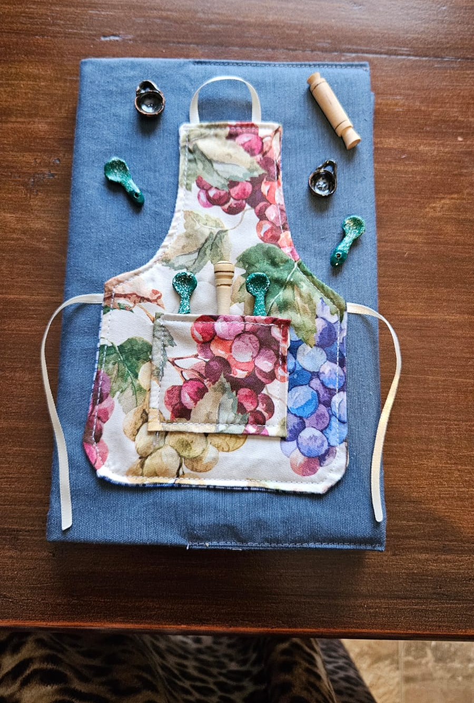
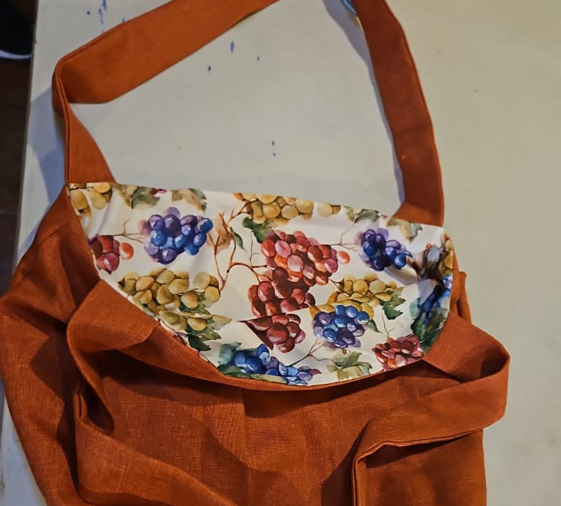

Slide 11
Extras
Donations from the students will be received each class at their discretion. So that we can buy more machines to extend the ministry to others in our community.
Classes begin Monday, Feb 5th at 5 p.m. (Classes continue each Monday)

Slide 12
Religious perspectives
Prayer and meditation will be part of the program at the beginning of each class.
Without proselytizing, demonstrating the love of God in tangible, life-changing, practical ways.

Slide 13
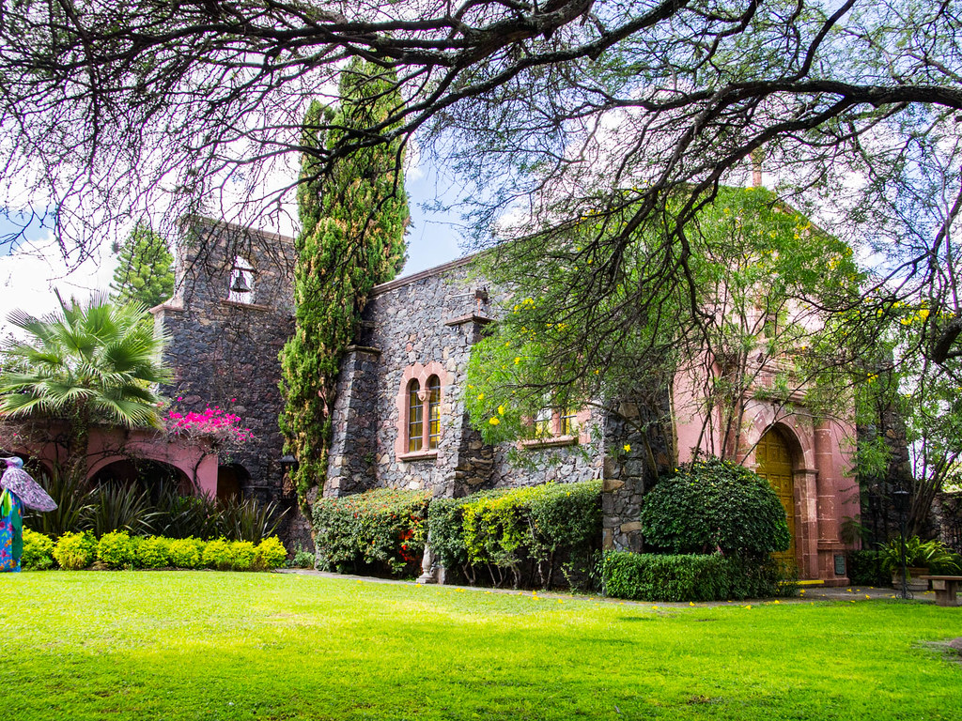
Working for God´s Kingdom

