Slide 1
“La Capilla”
Sport Social Project
for
our community
Anglican / Episcopal Church.
San Miguel de Allende

Slide 3
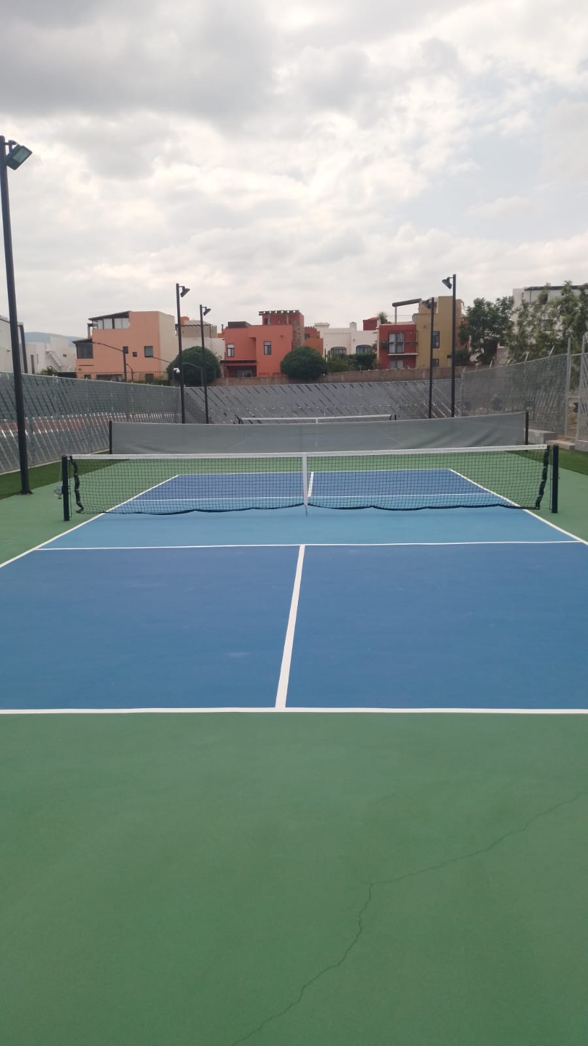
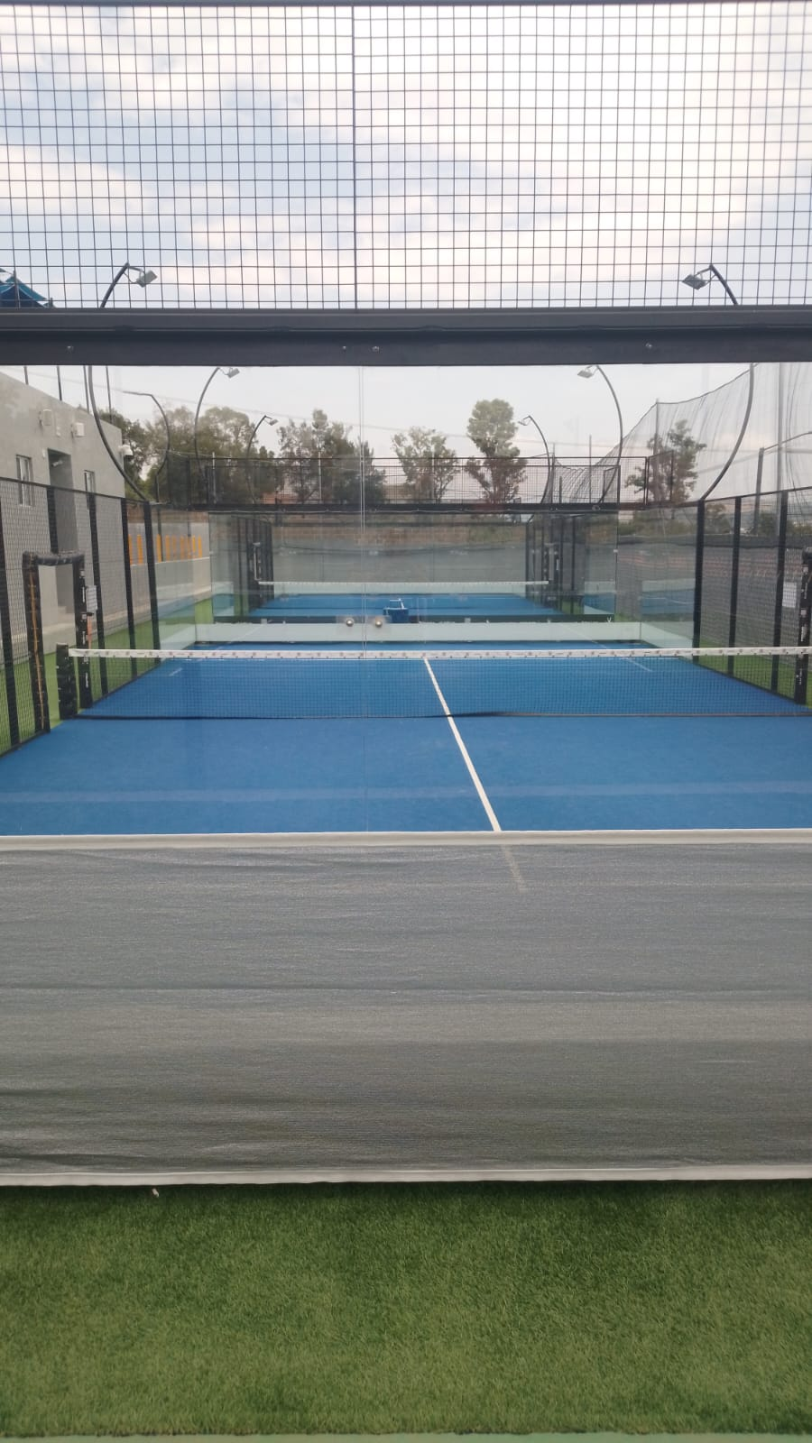

Slide 4
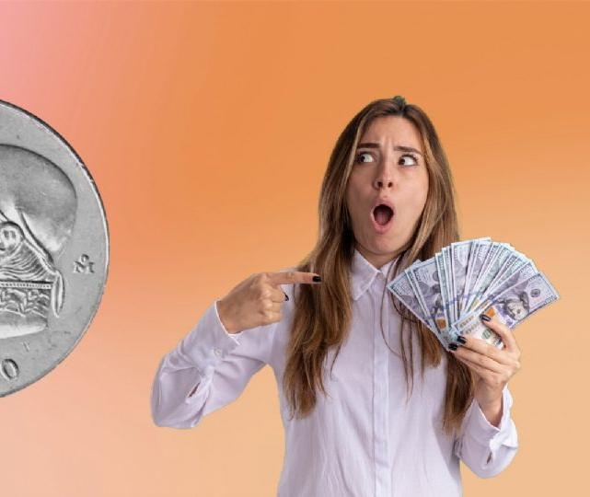
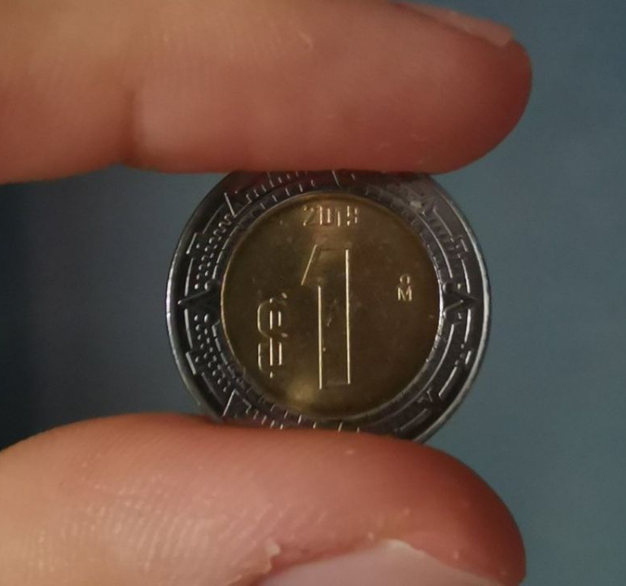
Name of the program
“Clases de a peso”

Slide 5
Mission
To promote racquet sports for young and adult people in our community, assisting them toward finding greater joy and dignity in their personal lives; furthering their physical and emotional development through sports.

Slide 6
Vision
Offering a location, materials (rackets, balls, courts) and instruction to under-served youth and adults, we provide an opportunity for personal development and social integration within the San Miguel de Allende community.

Slide 7
Activites The fundamental idea is to develop boys and girls in Tennis
1: Warm up
2: Forehand stroke.
3: Backhand stroke.
4: Volley right side.
5: Volley backhand side.
6: Bottom right glass.
7: Bottom reverse glass.
8: Right side glass.
9: Left side glass.
10: Reactions in court.
11: Consistent rally and shot directions.
12: Serving.
13: Game regulations.
14: Coordination.
15: Speed and reaction exercises.
16: Play points.

Slide 9
Expenses to began
20 padel racquets for 20 kids: The cost of each racquet is $2,100 pesos. Total of $42,000.00 pesos (Observation: these racquets normally cost $3,200 pesos each, but we are receiving a discount from the owner of “La Capilla”) Racquets are the major expense.
2 baskets for balls: $6,000.00 Pesos
3 boxes of balls: $10,200 pesos. (This quantity suffices for 4 months) We need to buy the same number of balls 3 times a year.
Bottles of water: 5 bottles of 20 liters. $600 pesos (Later we will know how much we spend on water a month. Each bottle costs 40 pesos to be refilled.)
Fruit: $250 pesos per day.
Toilet paper and soap: $500 pesos a month
Energy bars: $800 pesos a month (buy at Costco) bar per kid, per day.

Slide 10
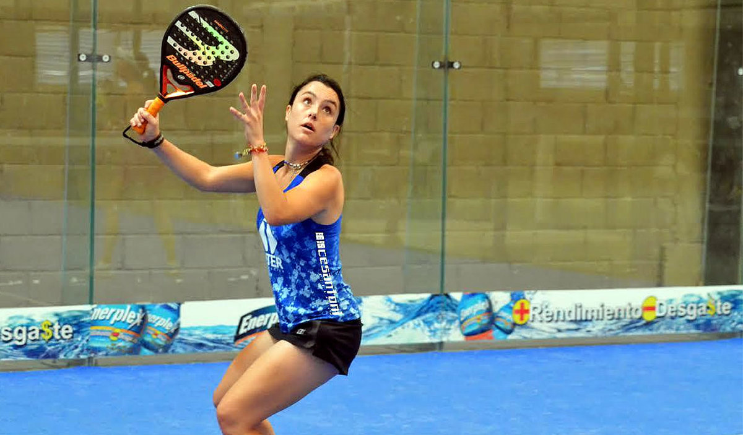
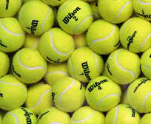
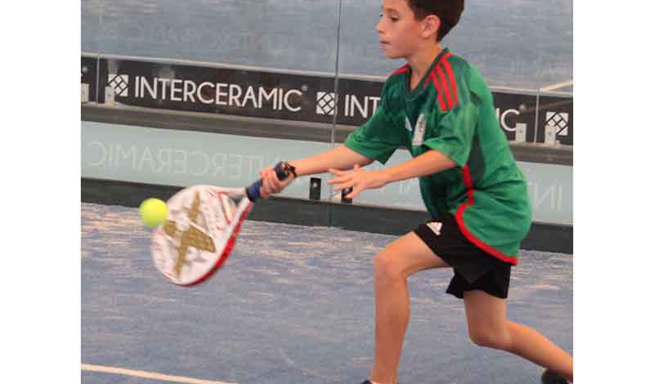
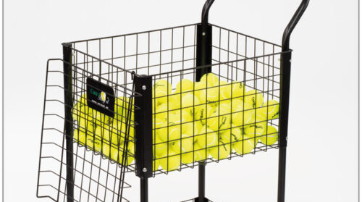

Slide 11
Salaries by month
Coach salary: $500 pesos per class. We will have 2 coaches each day, totaling $1,000 pesos a day.
Children´s Manager: $6,000 pesos (Monthy payment)
Supervising children and young people, modeling appropriate behavior and insuring respect for “La Capilla” and over-seeing equipment and the distribution of supplemental materials.

Slide 12
Extras
We may need to consider the purchase of tenis-shoes, shorts, t-shirts, etc. for less advantaged program participants.

Slide 13
Perspectiva religiosa
Without proselytizing, demonstrating the love of God in tangible, life-changing, practical ways.

Slide 14
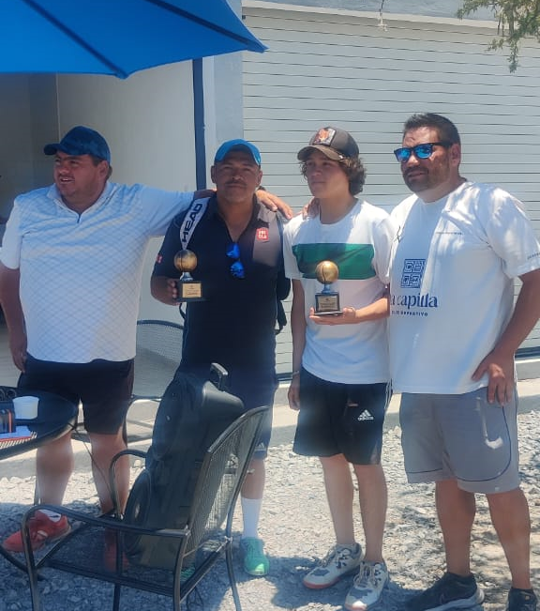
Coaches
Cristian Ashby
Jorge Ashby
Padre Miguel (visits to play)

Slide 15
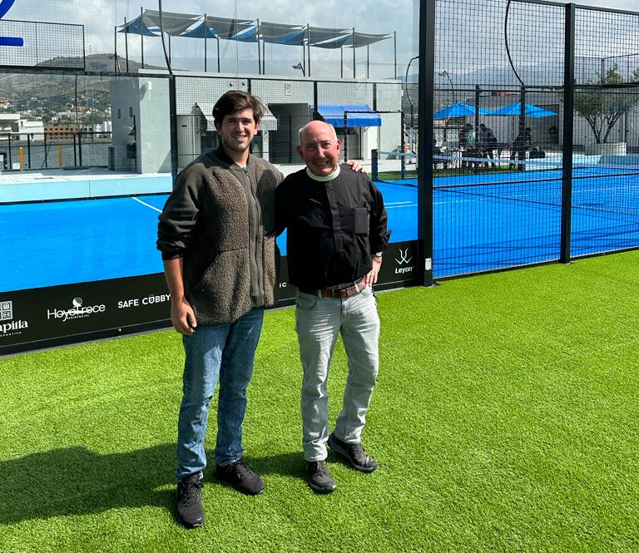
Program development members
Andrey and Joe López
Rodrigo Muñoz
Rodrigo Muñoz Jr.
Lynn Ramsey
Luis Canales
Canon George F. Woodward III
Padre Miguel de Jesús Rangel H.

Slide 16
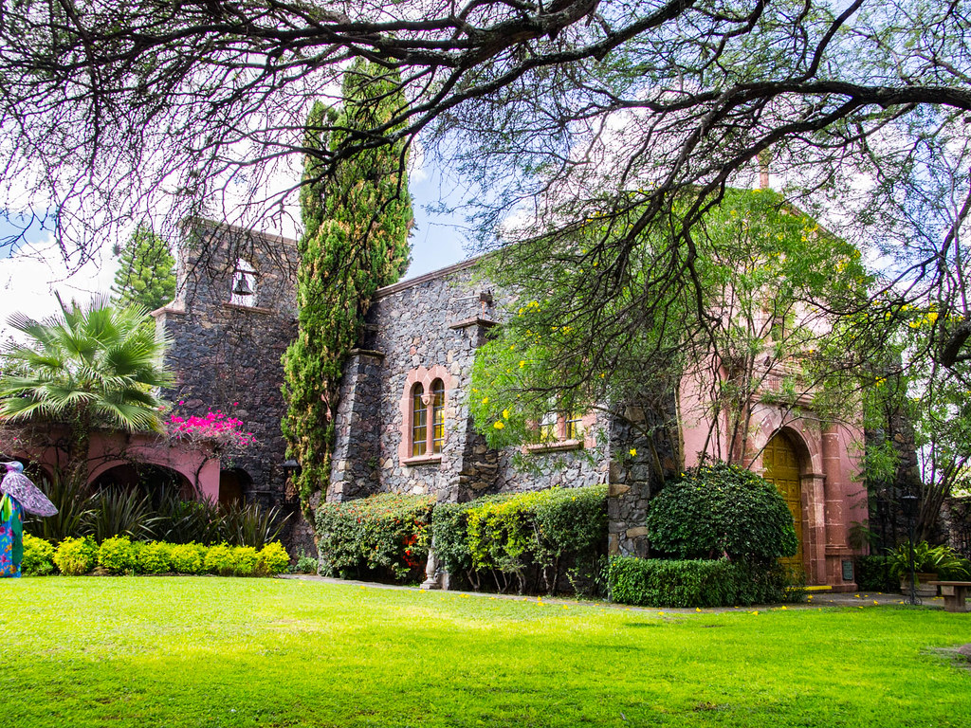
Working for God´s Kingdom

